Slide 1
Double hashing with passbits
Information Processing Letters 96(2005) 162-166
Walter A. Burkhard
Presenter: Jun-Shiong Lin
Date:2006.2.24

Slide 2
Abstract
Double hashing with bucket capacity one is augmented with multiple passbits to obtain significant reduction to unsuccessful search lengths. This improves the analysis of Martini et al. by providing a closed form expression for the expected unsuccessful search lengths.

Slide 3
Introduction
Double hashing is an efficient scheme for the generation of probe sequences within open-addressing.
Ex:
record: cat
probe sequence: 1 , 2 , 3 , 4 , 0

Slide 4
Introduction
The run-time performance of double hashing is well known via both
(1)expected successful search length
(2)expected unsuccessful search length

Slide 5
Introduction
Passbit =
Subsequent unsuccessful searches will terminate at the first bucket encountered with a false passbit rather than locating an empty bucket.
True (the bucket is full)
False (the bucket is not full)

Slide 6
Introduction
Multiple passbits utilizes an implicit partitioning of the hash-domain into
g≧ 1 equal-sized blocks (approximately)

Slide 7
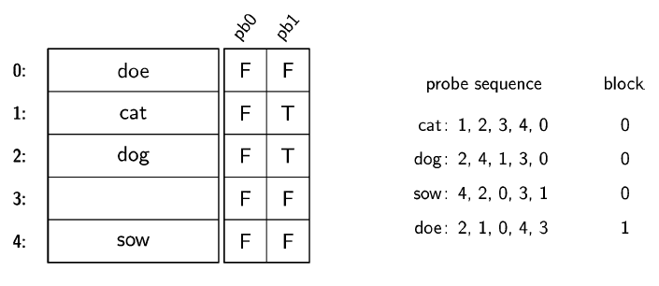
Example 1
Order: cat -> dog -> sow -> doe
n = 5 (buckets) , m = 4 (records) , g = 2 (passbits)

Slide 8
Example 1
For table without passbits:
The load factor α = m/n = 4/5 = 0.8
the expected unsuccessful search length = 5

Slide 9


Example 1
Theorem 1. A table utilizing double hashing configured with g ≥ 2 passbits per bucket with loading factor α has expected unsuccessful search length E[Lu] where
For the table with g = 2 passbits
the expected unsuccessful search length is
≈ 1.44

Slide 10
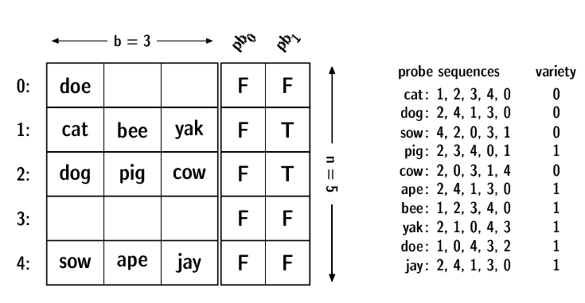
Example 2
n = 5 buckets , b = 3 slots per bucket ,and g = 2 passbits per bucket

Slide 11
Passbits analysis
The unsuccessful search length Lu designates the number of buckets examined to determine a record r does not reside within the table.
Let q designate the probability passbit is true (a bucket is filled).

Slide 12

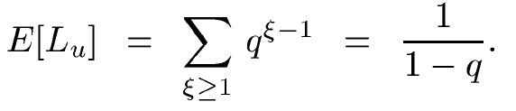
Passbits analysis
The probability an unsuccessful search requires at least ξ probes is
the expected unsuccessful search length is

Slide 13
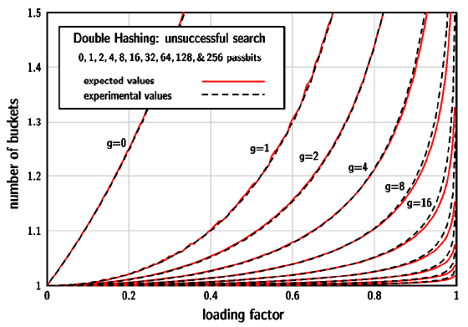
Experimental results

Slide 14
Conclusions
The expected unsuccessful search length for double hashing can be significantly reduced by the use of passbits, often an insignificant appendage of additional space.

